Slide 1
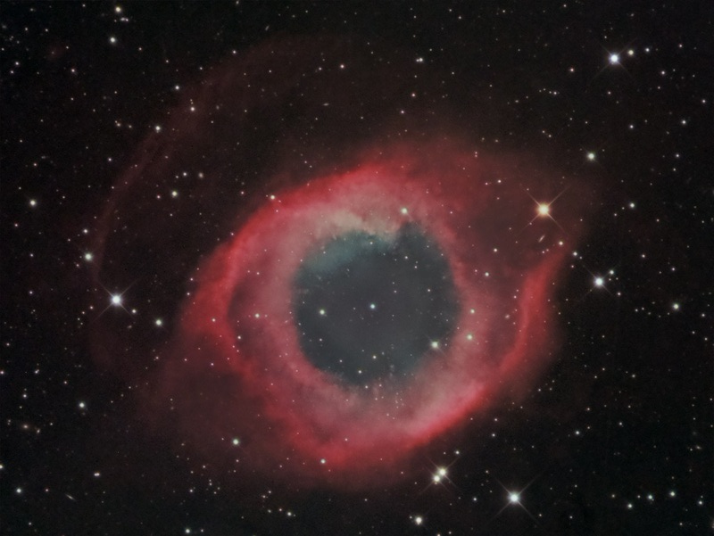
Math in Astronomy
June 2014 Workshops – Jay Ballauer – Lake Ridge HS

Slide 2
Jay Ballauer
www.allaboutastro.com
Professional Timeline
1994: First year as a teacher
2003 – 2007: First Astronomy Director at 3RF (Three Rivers Foundaton) near Crowell, TX
Summer 2010: Hired at Mansfield Legacy High School to teach mathematics
Summer 2012: Became a Lake Ridge High Schools founding teacher
Astronomy Timeline
1997: Started with Comet Hale-Bopp; brought first scope (10″ Meade LX-50)
1997 – 2000: Mostly visual observing and film imaging
2001 – 2003: CCD imaging
2004 – 2006: My “Golden Age”
2007 – present: Private consulting; “Married with Kids”

Slide 3
Learning Groups…
Your group assignments for today are represented by the Messier object named on the index card in front of you.
These represent different types of objects. Match yourself with those people of the same object type.
We will have open clusters, globular clusters, galaxies, planetary nebulae, and emission nebulae. If you don’t know the object by heart, Google it!
Notes:
Open clusters – M7, M35, M45, M46,
Globular clusters – M3, M4, M13, M53
Galaxies – M33, M51, M81, M104
Planetary nebulae – M27, M57, M76, M97
Nebulae – M8, M16, M42, M78

Slide 4
Activity ONE: The Monty Hall Problem
Suppose you’re on a game show and you are given a choice of 3 doors…
Behind one door is a car; behind the other doors, goats. You pick a door, and the host, who knows what’s behind the doors, opens another door, which has a goat.
He says to you, “Do you want to change your pick to the other door?”
Is it to your advantage to do so?

Slide 5
Why Math in Astronomy?
…sometimes, reality isn’t intuitive
Science is not just observational. You must have a way to make sense of those observations.
Math is the “language” of the data.
Notes:
In the Monty Hall Problem, we are showing that truth is not something that can be determined by intuition or a majority vote. Intuition leads to questions and makes for worthy hypotheses, but we need solid experimentation and interpretation of the data to provide accurate answers to those questions.

Slide 6
Two Approaches…
Agenda One:
“The Math Guy”
Agenda Two:
“The Astronomer”
I could teach you some math things to enhance the things you are always doing in the classroom/curriculum.
This might be what you expect from a math teacher, right?
I could teach you some ways to associate math in ways you might not have thought.
This might be what you expect from a guy who’s done some actual astronomy, right?
Let’s do both!
Notes:
The hardest part of teaching math is that we have little time to make real connections between it and life. You can help us there.

Slide 7
Agenda One: A Math-Guy’s Perspective
The Astronomy Today text contains some really nice breakout pages in each chapter that deals with the mathematics in depth. As an outsider looking in, I would see resistance in digging into those topics because…
As science teachers, perhaps we aren’t comfortable with the math?
As “just” a teacher in a very applied discipline, perhaps we lack a real-life perspective that would help us develop the concepts more fully?
We figure that they will get all the math they need in their MATH CLASS!
Let’s spend some time looking at how a math teacher would value astronomy as a laboratory for doing math!
Notes:
Catch-22…As a math teacher, we lack the time and resources to provide meaningful enrichment to our current units of study, so we rely on the science teachers to give math application. But as a science teacher, we lack the time and resources to involve students into a deeper understanding of the math involved in the principles we teach.
These, I believe, are the reasons I was asked to speak to you today.
How might we address the

Slide 8
Math Topics (with Astronomy-related applications)
Functions: Independent/dependent; formulaes
Units of Measure: Electromagnetic waves, far-off worlds
Coordinate Systems (Cartesian, polar): Astrometry
Trigonometry: Distance; angular separation
Sinusoidal Curves: Planetary/lunar periods; electro-magnetic spectrum
Conics: Optics; orbits/Kepler’s Laws
Graphs and Tables: Blackbody curves; H-R diagrams
Exponentials/Logarithms: Powers of 10; Magnitude scale
Direct/Inverse Variation: Inverse-Square Law
Probability/Statistics: Drake Equation; Measuring Risk
Notes:
About Chapter 1 in the Chaisson text over “Charting the Heavens”:
Of all the chapters in the Chaisson text, THIS chapter would benefit the most by doing ACTUAL astronomy.
Of all the times in the year, THIS is the time when you are least ready to do ACTUAL astronomy.
So, how might you handle this?
Put Chapter 1 off until later in the year when you do observing?
Revisit the concepts of apparent angles and sizes when you DO some observing?

Slide 9
Mathematical Functions
High school math education is all about progressing students algebraically through the various way that one variable can be determined by another.
Linears
Quadratics
Absolute Value
Square Root
Cubics
Higher-order Polynomials
Trigonometric
Polar and Parametric
We teach kids how to develop functions from data, but we do a poor job of getting kids to understand how and why they will be used.
Every equation formula, every science “law.” and every functional relationship you show is VINDICATION for the math teacher, who is tired of saying, “Oh, you’ll use it someday!”

Slide 10
Units of Measure
Students in math classes have a poor understanding of units of measure. Whereas we can teach them to convert from one measure to another, we can’t always get students to picture them in reality. You can help!
Small-world measures:
Microns, Angstroms, and Nanometers are often used interchangeably when dealing with light frequencies.
On assignments where a student must give an answer in these units, may I suggest that you require BOTH nanometers and angstroms?
The more they see these in reality, the less confused they will be in their math class.
Big-world measures:
Astronomical Units, Parsecs, light-years
These aren’t used in a math classroom
Angular measures:
Degrees and Radians
Critical in PreCalculus

Slide 11
Coordinate Systems
Every object, on earth or in space, can be named from a reference “origin”
In space, this science is known as astrometry
There are 2 different type of coordinate systems used in high school mathematics:
Cartesian graphs (Euclidian geometry)
Polar graphs (latitude/longitude; Rt. Ascension/Dec)
The following activities support “More Precisely 1-2” in your Chaisson text.

Slide 12
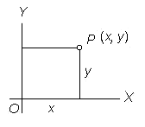
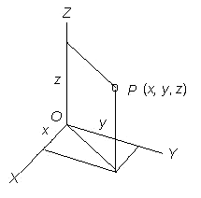
Cartesian reference
In 2-D
In 3-D

Slide 13
Cartesian System Activity 1
Using the provided reference frame and strings, find the Cartesian coordinates of different objects in the room
Data Sheet | Cartesian Coordinates
 | x | y | z
Object1
Object2

Slide 14
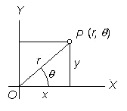
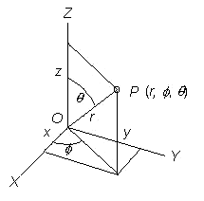
Polar reference
In 2-D cylindrical
In 3-D spherical

Slide 15
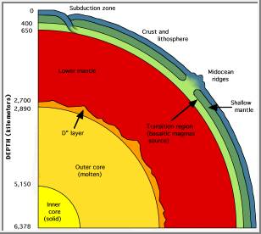
Earth Science
Y
You can see in this case how it is easier to use polar coordinates rather than Cartesian because the length is the same and all we have to do is vary the angle instead of measuring the x and y for each point on the mantle surface.
length
angle
X

Slide 16
Cornhole Coordinates Activity
Fun activity to prepare them for polar coordinate systems!
Notes:
- See Complete activity on the Word Document supplied in your Support Activities Folder.

Slide 17
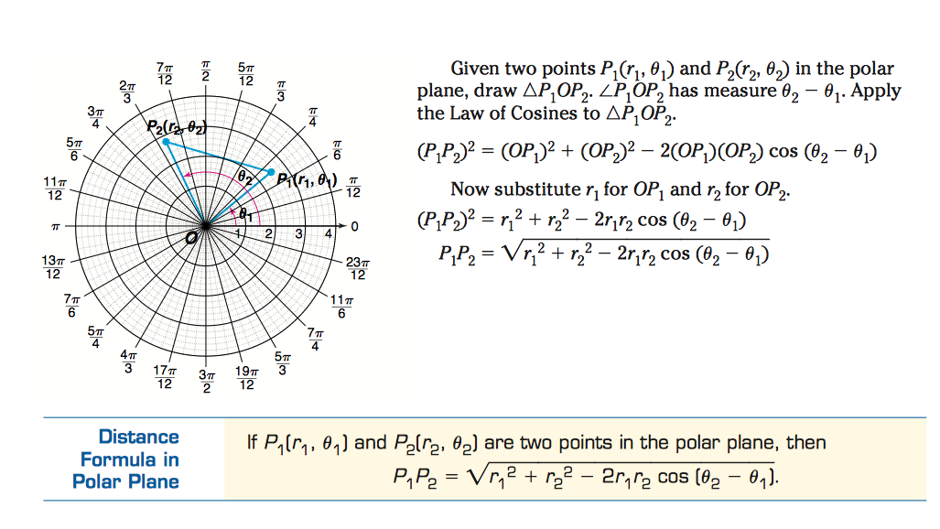
Polars Activity 2
Use Law of Cosines (polar distance formula) on a photograph to compute angular separation between sky objects based on their (RA, Dec) coordinates.

Slide 18
Activity (cont.)
Find the angular separation (distance between) M84, M87, and M90 based on their coordinate values below:
M84 (12^{h} 25^{m} 04^{s} RA, +12° 53’ 13″Dec)
M87 (12^{h} 30^{m} 49^{s} RA, +12° 23’ 28″Dec)
M91 (12^{h} 35^{m} 26^{s} RA, +14° 29’ 47″Dec)
Markarian’s Chain in Virgo by Jay Ballauer
Notes:
Remember:
- It is helpful to have students re-plot these on an actual polar reference plane.
- Distance values are measured from the poles in this system, meaning that Dec measurements must be subtracted from 90 degrees.
- The angles in Right Ascension must match the units for Declination prior to using the formula, so they must be converted from HMS to degrees.
- Hint: There are 15 degrees in one hour.

Slide 19
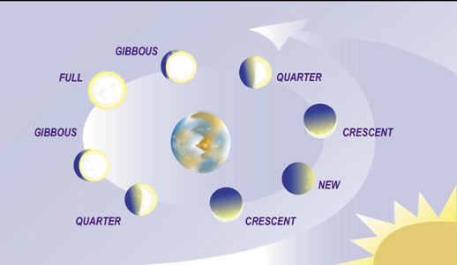
Sinusoidal Curves: The Lunar Period
If we plotted a graph of the lunar period (x) vs. its phase (y), we would produce a trig graph.
Lunar Day | Phase
1 | 100% (Full)
7 | 50% (waning)
14 | 0% (New)
21 | 50% (waxing)
28 | 100% (Full)

Slide 20
Trigonometry: Apparent Diameter (More Precisely 1-3)
Damian Peach is today’s foremost planetary imager.
Jupiter, at opposition, is 50” (arc seconds) in diameter.
An arc second is 1/3600 of a degree
Our moon is 34 arc minutes at maximum perigee, or .6 arc degrees.
How many Jupiter apparent diameters can fit across the moon’s equator?

Slide 21
Activity (cont.)
In 2003, Mars approached earth opposition as its closest distance in 60,000 years.
Since that time, the Internet is the source of the “Mars Hoax,” whereas at every opposition we learn that Mars will appear in the sky as the moon!
Using Mars’ apparent diameter at its maximum opposition, compute the number of Mars apparent diameters that fit across the moon’s equator.
How far must you be from a basketball and softball to model the apparent size of Mars and the moon respectively?
Easy math: Use the formula for apparent diameter.
Complex math: Rewrite the formula below in terms of apparent diameter to solve the problem.

Slide 22
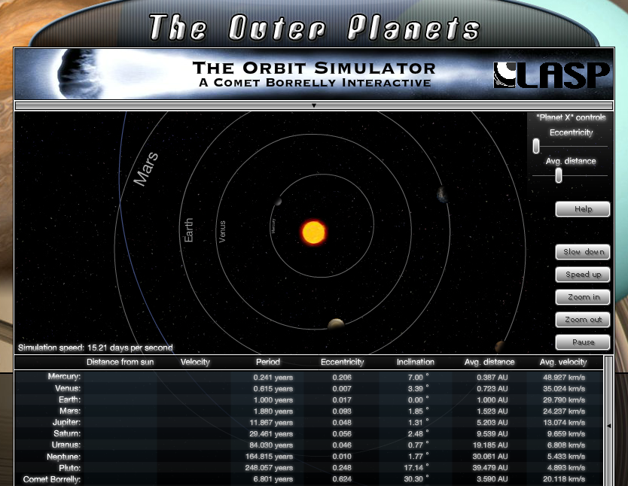
Activity: Ellipses and Eccentricity (Kepler’s Laws)
Orbits are ellipses, a conic section that is studied in Algebra II and Precalculus.
An ellipse has major/minor axis and two-foci on the major axis.
Using the Orbit Simulator tool, experiment with different eccentricities and distances for “Planet X”
http://lasp.colorado.edu/education/outerplanets/orbit_simulator/

Slide 23
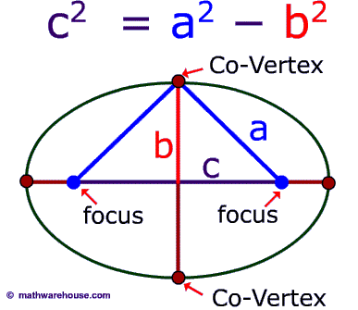
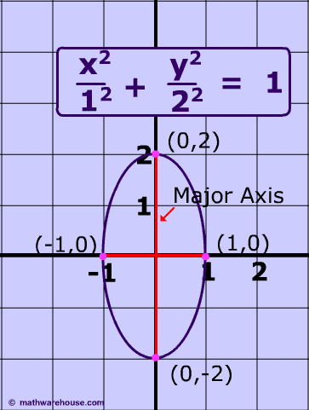
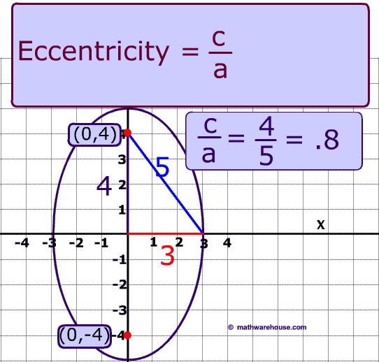
Ellipses & Eccentricity (cont.)
Notice in the simulator that the more eccentric the orbit becomes, the more off-center the sun is. “Eccentric” literally means “off-center.”
Using the Simulator, can your students compute equations to represent all planetary orbits?
How about for comets?
Notes:
Notes for Activity:
You can use the “Avg. Distance” in your computations, but for more accuracy you can use actual periheilon/aphelion information. This information can be gained from the Internet OR you can use planetarium software to measure it.
For at look at Kepler’s 2nd Law, you observe the radius vector as it moves in equal periods in the orbit. This will produce equal area triangles. See http://cseligman.com/text/history/kepler2.htm.
For a look a Kepler’s 3rd Law, the period^2 will be proportional to the semi-major axis^3. What this implies is that in bigger orbits it takes longer to go around, for TWO reasons: (1) you have further to go in bigger orbits (2) you move slower in bigger orbits
What is the difference between aphelion/perihelion, apogee/perigee, and apolune/perilune?
Other nifty orbital calculators:
http://www.mc.maricopa.edu/~kev2077220/flash/kepler.html
http://www.windows2universe.org/physical_science/physics/mechanics/orbit/perihelion_aphelion.html

Slide 24
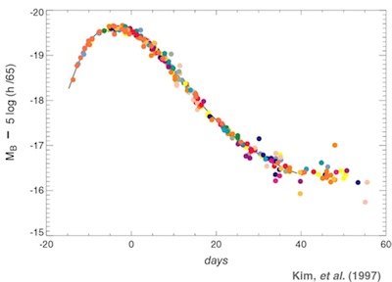
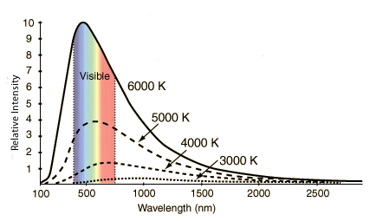
Graphs and Tables
Blackbody Curve: The emission of energy (heat) is inversely proportional to the length of the wavelength.
Light Curve: Graph that shows the brightness of an object over a period of time.
The ability to read graphs and tables is important for both of us math and science teachers. The more we can have students interpret data, the better we will be.
It’s the precursor to writing and understanding functions.

Slide 25
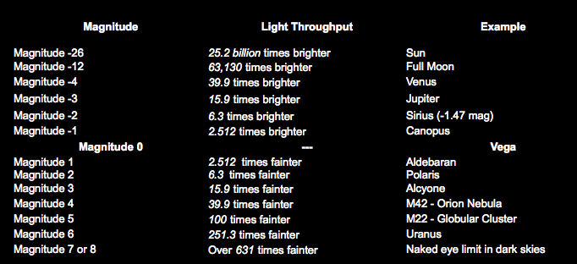
Exponentials/Logarithms Activity 1
Apparent Magnitude is a logarithmic scale stemming from the principle that objects that are 5 magnitudes less will be 100 times fainter (and vice versa).
Derive a formula both exponential and logarithmic forms…
Notes:
Lots of Science applications here:
- Decibels
Richter scale
pH scale
Carbon Dating

Slide 26
Exp/Log Activity 1 (cont.)
If 5 changes in a magnitude = 100 fold change in brightness, then how much would one change of magnitude be?
This becomes the “base” of the exponential/logarithm and can be derived by solving…
x⁵ = 100, or 2.512⁵ = 100
Another way of saying it? Each mag change is the 5th root of 100…or you multiply/divide by 2.512 each time you go from one mag to the next .
Written as a exponential function:
f(x) = 2.512^{x} , where x (input) is the number of changes in magnitude and f(x) (output) is how many more times an object is brighter than the other.
Written as a logarithmic function:
x = log_{2.512} y , where x is like above except is now the output and y (change in brightness) is now the input.

Slide 27
Exp/Log Activity 1 (cont. again)
Have students know which form to use…
Use the exponential when you want to compute how much brighter a star will seem to be as the magnitude changes.
Use the logarithm when you want to know how many magnitudes between a particular brightness difference.
Using the magnitude chart, star chart, or planetarium software, have students compute the differences in apparent magnitude between 5 named stars currently in the night sky and the sun or moon.
Then, have student compute how many apparent magnitudes a star must be in order for it to appear 5000 times fainter than a star like Altair?

Slide 28
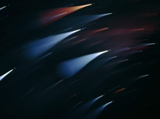
Logarithm Activity 2: Absolute Magnitude
Put a camera on a tripod, open the shutter for a long time, defocus the image gradually and you will produce a color image of the “southern cross,” like this one from Stephan Seip.
A picture is worth a thousand words…or at least one H-R Diagram!
CLASS PROJECT: By estimating the spectra of these known stars, in combination with their known distances and known apparent magnitudes, we can compute absolute magnitude. With enough images and enough stars, we can actually make a real, true to life H-R Diagram.
(abs mag M) = (app mag m) + 5 - 5 * (log d)
…where absolute magnitude is the capital M, apparent magnitude is the lower-case m,
d is the distance to the star in parsecs, and "log" is the logarithm base 10 function

Slide 29
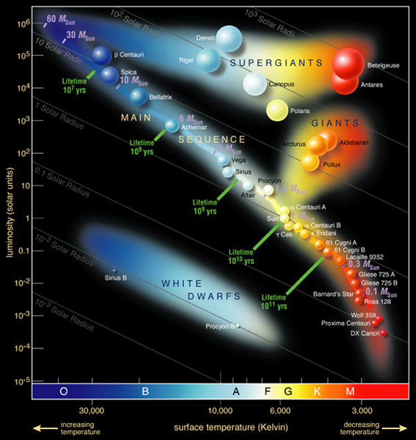
Logarithm Activity 2 (cont.)
Practice Question #1: The star Deneb, in Cygnus the Swan, has an apparent magnitude m = 1.26 and a distance d = 500 parsecs. What is its absolute magnitude?
Practice Questions #2: The Sun has an apparent magnitude m = -26.5. What is its absolute magnitude? (Hint: You must convert its distant into parsecs; 1 light years = 0.306594845 parsecs)
As you receive the data from the class, have them plot their stars on a large graph you have labelled as...
D.I.Y. H-R Diagram!
Then, compare with the real deal!
Notes:
Yeah, it’s an advanced activity, especially in light of the astrophotography; however, when supplied with ALL the data by the teacher, students can give groups various stars, make them compute their absolute magnitudes from the data, and then come ready to plot their results onto the class H-R graph. Cool beans!

Slide 30
Direct/Inverse Variation: Inverse Square Law
In our math classes, especially Algebra I, we often do not have the algebraic understanding to delve deeply into this topic and, for this reason, we look for ways to shorten the unit due to time constraints. Because of its wide application to just about anything that “spreads,” it’s very relevant and important to study. If you have the time to allow “discovery” of this law, then please do so!
NASA Inverse Square Law of Light Project – This is a rocking project. If you have the time and resources, I would do this, or some variation of it.
ISL Worksheet – Nice, easy, quick worksheet to do some computing of light intensities.
TI-nspire Light Law Activity – For those with TI-nspires (adaptable for Ti-84s), here is a nice activity.

Slide 31
Probability/Stats…
The Hubble Deep Field (1995) has field of view of 2.5’ (arc minutes), which is the rough equivalent of a grain of sand taken at arms length. 1/24 millionth of the whole sky.
10000+ galaxies are in this field.
How many total galaxies? Stars? Planets? Life? Too complex?
Lead kids through Drake Equation to produce a guestimate of how many communicative civilizations might be present within our own galaxy or let Wolfram Alpha do it.
http://www.wolframalpha.com/input/?i=drake+equation
How might this be relevant to SETI and your study of it?
Notes:
Important because self-centered kids can’t see the universal perspective.

Slide 32
Notes:
http://www.wolframalpha.com/input/?i=drake+equation

Slide 33
Agenda Two: An Astronomer’s Perspective
What might an astronomer add to what is in a typical astronomy curriculum?
What might we do to enrich the activities currently being done?
How might an astronomer approach the current curriculum?
In terms of practical math actually being used by professionals.
In terms of underlying math that is involved with doing applied astronomy.

Slide 34
Astronomy Topics (with Math-related applications)
Stellar radii (luminosity and radiation laws)
Light and Spectra
Light scatter and Rayleigh (lunar eclipses)
Star Magnitde (logarithms)
Radiation Laws and Atoms
Diffraction and Telescope Resolution
Poisson Characteristics
Star Profiles
Object Signal/Noise Ratios
Optics
Visual Astronomy
Astrophotography
Image scale
SNR
Golden Ratio (law of thirds)
Notes:
Types of math? Graphs and tables. Exponentials and logarithms. Right Angle Trig. Sinusoidal curves. Quadratics. Probability. Normal Distribution. Sequences. Vectors.

Slide 35
Why is this the best subject to teach?
Credit - Rammshytn http://youtu.be/Z8axMaBL4uo
Notes:
This is my central truth as a human being.

Slide 36
What can I see through my scope?
The human eye’s aperture is ~8 mm (at best). The difference in light gathering power between apertures of different sizes can be computed by dividing the two apertures and squaring the result. So, with a 100mm (4” inch) scope…
Difference in Light Power = (100mm/8mm)² = 156.25 times
Let’s use our knowledge of the magnitude scale from earlier to compute light gathering power in terms of magnitude’s of improvement…
Since we know that a 5 “mag” difference is a factor of 100 in apparent brightness, then how many “mags” improvement should we see with the 4” scope listed above?
Difference in Mag = log_{2.512} (Difference in Light Power)
So, Difference in Mag = log_{2.512} (156.25) = log 156.25/log 2.512 = 5.48 mags
Thus, if I observe in mag 4.5 suburban skies, I should be able to see magnitude 9.98 objects with my 4” telescope!!!
Notes:
There are several things we can derive from this.
1.) The darker skies you can observe in, the more you can see.
2.) The more aperture you have, the more you can see (given equal optics) regardless of where you observe.
3.) Not everybody has the same eyes. These figures can vary by as much as a magnitude depending on the sensitivity of your eyes and your experience level.
4.) This does not include objects or details detected with averted vision. This observing technique can add perhaps a half-magnitude to the above figures.
5.) This assumes you are using equipment that does not limit the amount of light entering the eye, such as bad optics, unsteady mounts, and poorly performing eyepieces or barlows.
6.) Limiting magnitude determines if the light can be detected. Factors such as resolving power, contrast, atmospheric stability and clarity will influence how well you see this light.
So, back to our original question...what can I see with my scope?
Stars with magnitudes in the above ranges are a given. If you have a 4 inch scope in dark skies, you will see ~12th magnitude stars. As for objects, that depends on the surface brightness of the object and the ability of your telescope to present that light in a way that is observable. In other words, it may not be enough for you to merely see an 11th magnitude galaxy. You might need more aperture or darker skies to see certain aspects of that galaxy that makes it interesting. It's the difference between seeing M51, the Whirlpool galaxy, as a "faint fuzzy" or as a galactic spiral.
Regarding deep sky objects (DSOs), the Messier catalog of 109 objects is the most observed list of deep sky splendors. The hardest to see of these objects might not be the ones designated with the faintest magnitude measurements. For example, M76, the Little Dumbbell Nebula, is normally considered the faintest object, at around 10.2 magnitude or so. But I find this object much easier to see than fainter galaxies such as M74 and M77 since their magnitudes are spread over a larger surface area. To see the faintest of the Messier objects, you will need to have a scope/sky combination that gives you no less than ~10.5 magnitudes. That might be a 2 inch scope in dark skies, a 6 inch scope in suburban skies, or a 12 inch scope in city skies. But to observe these objects, you will need a combination of scope and sky that will reach into the 12th magnitude range. Only then will you be able to begin seeing certain features that the object may have. It's no wonder that in dark skies with a 24" Dobsonian reflector, some of these objects begin to look like their photographs.
So users of even small aperture scopes should not despair. Taken to a dark sky site, even a 3 inch telescope makes not only the entire Messier list detectable, but you can begin to see detail in any of these objects. In the same way, users of 10 inch scopes when used in the city might have difficulty seeing even the brightest of Messier objects with a certain amount of detail.
The difference between a 2 inch telescope and a 36 inch telescope is about 7 magnitudes. The easiest way to get these magnitudes back, without spending extra money, is to find a dark sky site. That 2 inch scope in dark skies performs similarly to a 12 inch scope in city skies.

Slide 37
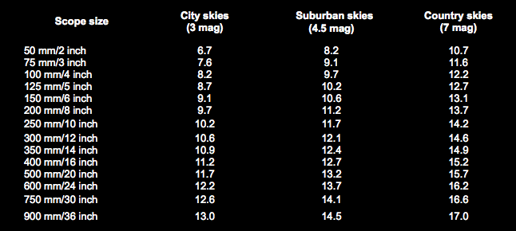
What can I see through my scope? (cont.)
ACTIVITY: Have students compute a maximum light gathering chart, such as below, to assist them in their observation planning and data logging.
What is the value of Dark Skies? What is the value of increased aperture?

Slide 38
Computing Magnification
The magnification of a telescope changes as the eyepiece is changed. Magnification can be calculated by dividing the focal length of your telescope by the focal length of the eyepiece.
Thus, if the scope has a focal length of 2000mm (typical of an 8” SCT), then…
2000mm f/l divided by 31mm eyepiece yields 64.5x power.
ACTIVITY: Have all student compute Magnification charts for their telescopes with their eyepieces and barlows.
What eyepieces would be optimal for this scope?
For another activity, have students Google “exit pupils for eye
Notes:
This, and the next activity, are two of the most practical math things that kids will EVER do. This is your opportunity to show them that, yes, you do use math in real life!!!

Slide 39
Computing TRUE FIELD
Eyepieces have an apparent field of view (APOV) according to design…
Plössl = 50° APOV
Panoptics = 68° APOV
Naglers = 82° APOV
Ethos = 100° or 110° APOV
Others are easily found by the magic of Google
The True Field of the eyepiece for a given scope can be computed by…
True Field = APOV ÷ Magnification
For example, suppose you have an 8” SCT with a 2000mm focal length and a 20mm Plössl eyepiece with a 50° apparent field.
Magnification would be 100x (2000mm ÷ 20mm).
The True field would be 50 ÷ 100, or 0.5° - about the same apparent diameter as the full Moon.
ACTIVITY: Have students compute their True Fields in addition to their magnifications for their eyepiece collections and given telescopes.
Notes:
Important!!!

Slide 40
Lunar Craters (Can I See The Flag?)
The moon is wonderful, except when you are trying to observe faint stuff. But because it is often observable during the day, it is critical to do as much as you can with our celestial partner!
ACTIVITY 1: Taking photos is easy, even with an iPhone through an eyepiece. Because of this, students should be encouraged to take lunar pictures often. Use these images as the basis for other mathematical activities…
Notes:
How to Image the Moon by Jay Ballauer
Amateur astronomers and astroimagers tend to treat the moon as light pollution. When its up, we’re inside! But on the occasion when we find ourselves looking at the magnificent craters, rilles, mountains, and maria of our celestial neighbor, we wonder why it is again that our moon catches so much flak!
The moon is the easiest object to shoot in the sky. Why? Because you can use any camera, on any mount, with any scope or lens to catch good shots. The moon is so bright that it requires simple, short exposures, which vary in length depending on its phase. Digital technology makes getting decent lunar images a breeze. Just setup the scope with a decent eyepiece, hold the camera up to the eyepiece, and shoot. If you don’t like the result, throw it out and try again!
Image Setup
If the moon takes up enough of the field of view, a camera with auto-focusing capabilities might actually do the focusing for you. It's worth a try if your camera has this feature. But for the most part, manually focusing the image will be required.
The best method would be to purchase an adapter to hold your camera to the eyepiece, thus freeing your hands to work the camera and to align your scope. Your focus should be close prior to hooking the camera to the eyepiece, but you’ll notice that the actual act of hooking up the camera to the eyepiece will throw off your focus slightly. For “point and shoot” digital camera users, you’ll use the LCD display as a visual guide to make sure you have proper focus. With SLR cameras, you have the ability to use the camera’s viewfinder. At this point, focusing should be done using the scope’s focuser, not the camera itself. Regardless, if the camera has autofocus, turn it off!
As a rule, you shouldn’t use the camera’s built-in zoom functions since it doesn’t actually add detail to the image. If you need more detail, you should use a more powerful eyepiece. Instead, you should use only enough zoom that will get rid of the “vignetting” in the image. Vignetting occurs because the camera’s chip is larger than the “hole” you are shooting through. It shows up as dark circle around the frame. Sometimes, enough zoom can be applied to rid yourself of this nuisance. But more than likely, you’ll just crop the image later in processing.
For best results, shoot the moon when at its quarter phases or less. This allows you to capture great details along the moon’s terminator while keeping the moon’s bright light somewhat attenuated.
Simple stuff, right?
Getting It Right
Unfortunately, many people who have been shooting the moon for years will be the first to tell you that shooting the moon is a hard thing to master. Decent images are easy, but great ones are tough! This is true for many reasons:
Focusing a shot that shows the full lunar surface is difficult because the face of the moon tends to have a different focus than the limb (edges).
The moon has the greatest dynamic range of any object. It’s tricky to process because you need to give equal balance to all brightness levels without over-saturating the bright areas or over-darkening the dark areas.
The moon is a shifty thing, bending, moving and blurring with atmospheric conditions, known as “seeing.” This means that the first shot you take will not likely be the best.
The brightness of the outer portions of moon can cause chromatic aberrations, or a bluish fringe when using lesser camera lenses and achromatic refractors.
The moon actually has color, which is very tough to shoot correctly. Most people shoot the moon in grayscale (black and white) to avoid these issues, but if you try your hand at color, there will likely be problems, either with chromatic aberration, atmospheric effects, or because of alignment issues when shooting tri-color. Using a mirrored scope gives you the best chance at success when doing color imaging.
A full moon can actually be too bright for some cameras such as with over-sensitive, dedicated astronomical CCD cameras. Shooting at high focal ratios of f/30 to f/40 is often the only way to make such cameras work with a given setup.
All these are important factors to consider when trying to get the perfect lunar image. But because we are people who gravitate to trends, there’s something else that deserves to be discussed in its own section.
To Stack, or Not to Stack...
Much has been made about “stacking” images. Free programs like Registax 2.0 can allow you to take multiple images, or even a video of the object, and then stack the individual frames together in processing to get cleaner, highest S/N (signal-noise ratio) images. However, it should be said that stacking lunar exposures is generally NOT a good idea. Most people will discover that a single frame image of the moon is the best bet. Why? Because as mentioned earlier, atmospheric seeing makes the perfect alignment of a stack of images very difficult. No matter how good the software, there will always be slight variations in crater shapes and sizes that do not align properly in the final stack of images. While the differences are often subtle, there will be areas in a stack, especially in crater littered fields, that look “overlaid” or lack sharpness.
What the lunar photographers should keep in mind is that image stacking is actually done for one reason and one reason alone: to remove noise from the image. The need for stacking becomes apparent when using any camera that has low sensitivity. This is because such cameras have difficulty overcoming the natural read-noise (noise floor) in an image, or the noise that is naturally a part of the camera regardless of how long the shot is. If the camera is not sensitive enough, it likely will not catch enough photons in the first place, at least not enough to overcome the read-noise.
A webcam is just such a camera. Same goes for an video camera or recorder. In fact, because shooting in video mode breaks down into rather noisy subframes, it makes sense to choose many of the sharpest subframes and average them together in software. In fact, stacking is required to take good lunar images with a high signal-to-noise ratio (S/N) with these cameras.
For those uninitiated to the idea, when you perfectly align images together, the good parts of the image, known as “signal,” will be in the same place. Because many forms of noise are often random in nature, each image in the stack will weaken the affect of the noise in the final average. The result is one final image that represents the best of each subframe.
If you have to stack your images in order to overcome noise, then choose only enough images to give you a good, clean image. Adding more images is unnecessary and you run the risk of corrupting the final stack by throwing in a subframe that doesn’t quite fit. Therefore, if your camera has the capability to shoot nice, single frames with minimal noise, then most often you will find that the best single shot during any given imaging session will yield a better result than stacking.
Processing Your Image
Once you have your single or stacked image, you are now ready to process it. Most image processing software will allow for basic “stretching” of the image and some form of sharpening. Essentially, that is all you really need. For this example, I’ll be using Adobe Photoshop.
Open the image and choose the Levels command. Within levels you’ll see the “histogram,” which is essentially a graphic representation of the number of pixels in the image at their brightness levels. The left of the graph will be the pixels with the darkest values. The right of the graph will be those with the brightest values. In a good lunar image, you’ll notice that the histogram takes the shape of a hill, slowly rising up toward the center of the graph and slowing falling towards the right edge. If your histogram doesn’t look like this, then your task is to make it so!
To give the background its proper level of illumination, drag the small triangle at the left side of the graph until it hugs up against the left edge of the hill. Do the same to the right side using that triangle. Just be careful not to “clip” the histogram by going too far. Clipping at the left side will cause a loss of data. Clipping at the right side will over-brighten areas of the image.
What you just performed is known as a “stretch” of the histogram, where you essentially equalized the brightness values across the entire range of illumination levels. At this point, the image should be quite improved.
If there is more “hump” to the left of the histogram than to the right, or vice versa, then the Curves command might come in handy. It’s too much to get into here, but experimenting with this tool is worthwhile. Likewise, using the “Auto Contrast” command might give you the same effect. Whatever you do, always check the histogram for clipping and/or balance. The more you understand the histogram, the more power you will get from your processing.
Finally, a little sharpening provides the final touch! Using the “Unsharp Mask” filter, apply a small amount of sharpening at 100%. 2 pixels will likely be too much. To bring out small, more localized contrast in the image, you might also try a large radius, 20% filter…just don’t tell anybody...it’s a trade secret!

Slide 41
“Can I See the Flag” (cont.)
ACTIVITY 2: Given perfect conditions, a telescope’s resolving power doubles with a scope’s aperture for a given wavelength. Thus, it becomes easy to approximate the minimum sized object (in arc seconds) that you can see through any scope of given aperture.
Resolving Power (Dawe’s Limit) = 4.56/aperture size (in inches)
For an 8” telescope, you should be able to resolve detail as small as…
4.56/8 or .57 arc seconds
Questions:
Using the current distance from the moon, what if the minimum width of an object visible on the moon’s surface using your telescope?
What is the size of an Apollo lander and flag?
What will you say to people who ask if you can see this with your telescope?
Can the Hubble do it?
What size mirror would you need, given perfect conditions, to see the flag?
Notes:
For a nice website on telescope equations (among other things) try…
http://www.rocketmime.com/astronomy/Telescope/ResolvingPower.html

Slide 42
Lunar Activities (cont.)
ACTIVITY 3: Take images of the moon at moderate power so that you see the entire lunar disk, only with enough detail to clearly see lunar features.
Produce a scale that can be used to measure certain features with a ruler…
(i.e. Divide moon’s known diameter or 3476 km by the diameter of the moon in your image in millimeter)
Use this “legend” to measure and compute distances of major craters and Mara in your image. How does this compare to actual, known feature sizes?
If you only shot a portion of the moon, how can you change the alter the activity to still make this work?
Can this activity be done with
apparent angular size and pixel scale?
Notes:
Activity 3 can be done with a print-out image of the moon OR on a computer screen or iPad?

Slide 43
Solar Math Activity (Space Math #137)
Modern astronomy, even amateur astronomy, is increasingly about data handling. Having students understand the storage requirements for continuous digital solar observations leads to nice math opportunities for the classroom.
Piggyback this with a solar observation, either in white light or h-alpha, and allow students to take images of the sun through their own cameras.

Slide 44
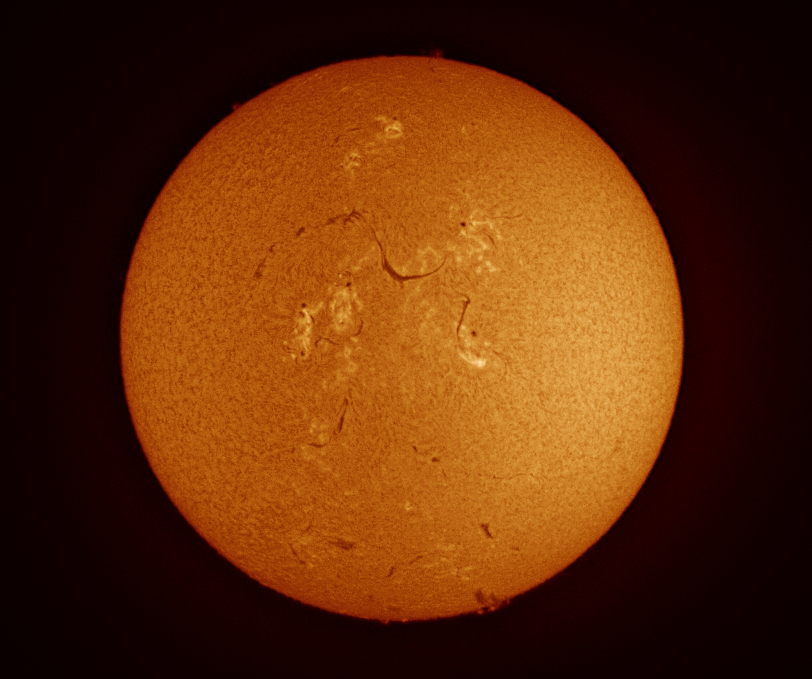
Activity #137 (cont.)
In the classroom, have students evaluate the size of the image files as the basis of Space Math #137 OR just use the solar observation to give a better perspective of the problem.
Additional ACTIVITY: After students take images or make sketches, have them estimate the size of the features drawn in “earth diameters”
Notes:
See the Space Math 137 Activity in the Supporting Activities folder

Slide 45
About Hydrogen-Alpha
H-alpha (656.3nm) is the foundation for most all observational astronomy:
Measuring distances of galaxies via redshift
Photographing areas of star development/birth
Seeing our Sun in detail.
Seeing differences in star spectral types according to h-alpha
As you study the electromagnetic spectrum relating to visual astronomy, you have a rich opportunity to incorporate math in your activities.
H-Alpha and Our Sun
Notes:
“H-alpha and Our Sun” (pdf) is found at - http://www.innovativeteachersbg.org/EAAE_CAS_2013/13_H_alpha_and_Our_Sun.pdf

Slide 46
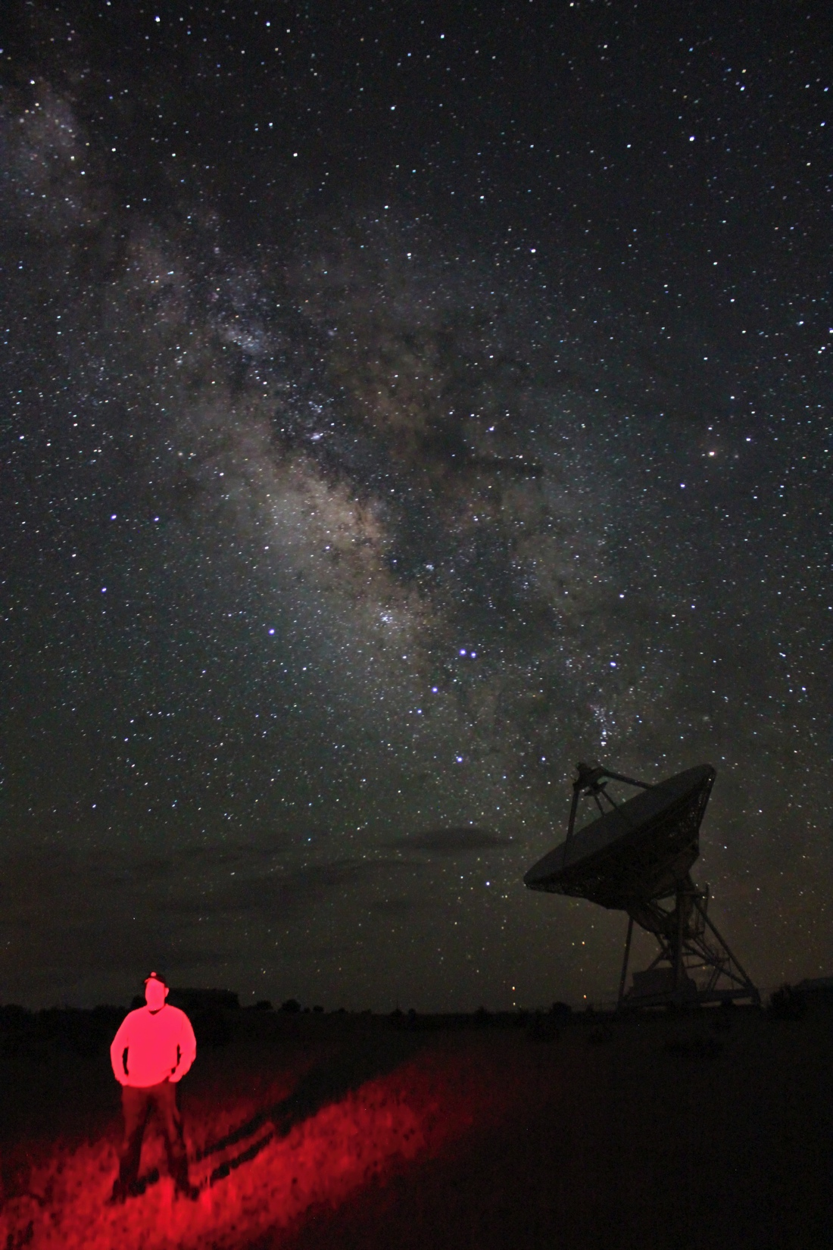
Astrophotography
With today’s digital cameras and scopes, there’s really NOT a good excuse for high school programs to begin collecting data, whether for pretty pictures, spectroscopy, photometry, or sky surveys.
But simply put, astrophotography a great way for kids to take ownership over any activity you give!
Please keep checking my website at www.allaboutastro.com as I add information about taking images of the cosmos!

Slide 47
Data Acquisition/Data Processing
Let’s demonstrate how math is involved in typical data processing.
Keep in mind that astronomical FITS data is readily available on line, as is some of the software that allows you to read it.
Histograms, FWHM star profiles, S/N ratios, noise contributions, stacking/integration algorithms, and pixel math are just a few of the ways that applied astronomy can improve one’s math skills.

Slide 48
Book Resources
Star Testing Astronomical Telescopes, Harold Suiter
Astronomical Algorithms, Jean Meeus
Mathematical Astronomy Morsels (5 volumes), Jean Meeus

Slide 49
Favorite Astronomy/Math Web Resources…
Space Math – http://spacemath.gsfc.nasa.gov
Cool Mercury stuff - http://www.messenger-education.org/teachers/teacher_index.php
Geometry Concepts – Stars: Powerpoint link here
http://www.astronomynotes.com
http://www.teachastronomy.com

Slide 50
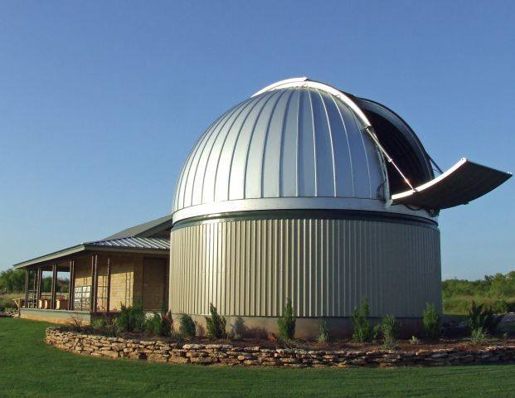
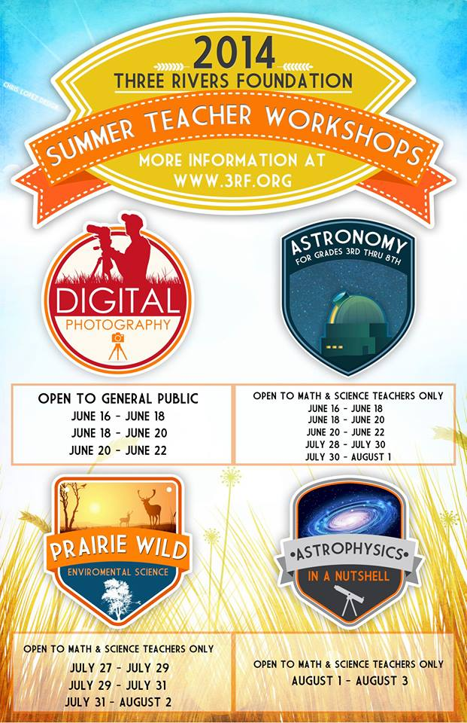
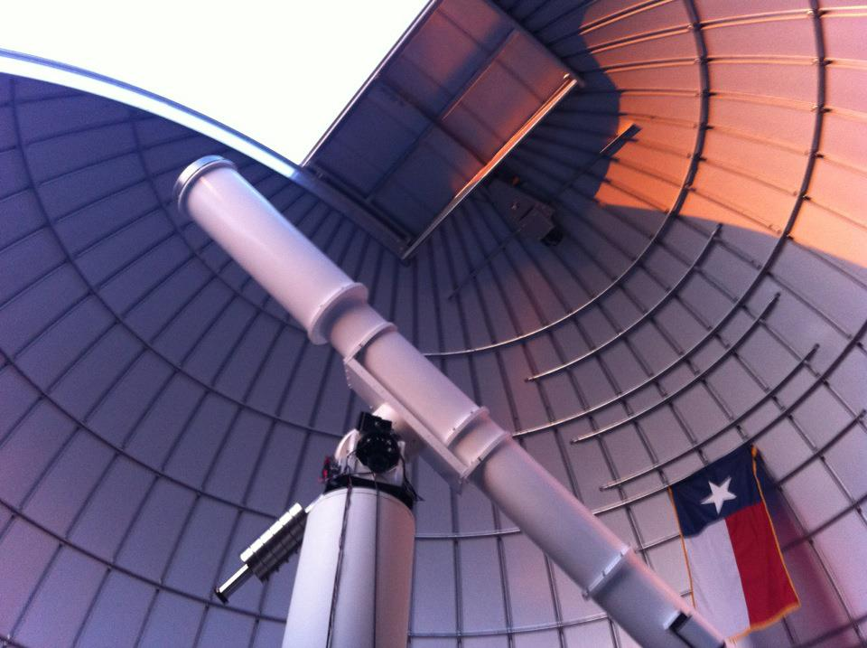
Three Rivers Foundation (3RF)
Crowell, Texas - (940) 684-1670
Notes:
About
Three Rivers Foundation (3RF Sciences, LLC) is a non-profit educational foundation dedicated to providing science and math opportunities to Texas teachers and students. 3RF's programs are funded in part by the Conley Foundation.
Mission
Engaging students, teachers and the public through hands-on educational outreach opportunities.
Company Overview
3RF's Comanche Springs Astronomy Campus (CSAC) is located in the heart of big ranch country in north central Texas. Home to telescopes, observatories and indoor and outdoor classroom space, CSAC serves visitors from across Texas, the U.S. and around the globe. Visitors enjoy programs covering topics ranging from astronomy to enviromental and earth science.
Description
This 700 acre facility lies in a corridor of dark skies that stretches from outside Dallas-Ft. Worth to Amarillo.

Slide 51
Thanks!
Any questions?
Contact me at jayballauer@misdmail.org
See www.allaboutastro.com
Facebook – Jay Ballauer

